Slide 1
Trunk Based Development CNA Canada.
Viquar Mohammed Khan
+1 224-436-0783

Slide 2
Note, for this presentation.. TBD = Trunk Based Development

Slide 3
Context

Slide 4
What is TBD?
Everyone develops on the trunk.
Bug fixes too.
No code freeze.
No merge hell.
Build never broken – always release ready.
Many more diagrams of what is not TBD ☞ Jez’s talk went in to that
Debate with me later please

Slide 5

Overlap with Continuous Delivery ?
You can just about do CD without TBD
You can do TBD without the CD step.
They go well together though.
TBD enables CD.

Slide 6
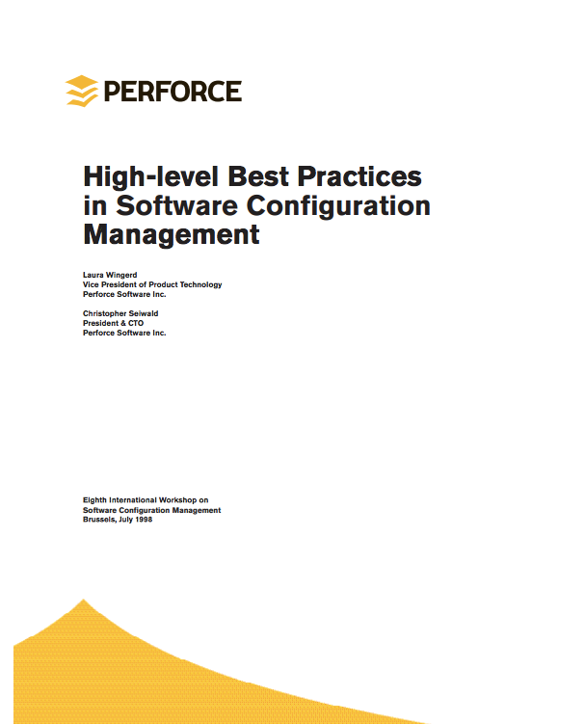
1998 Paper
Laura Wingard and Chris Seiwald on SCM best practices in 1998.
Trunk mentioned, but so is Mainline.
They mean different things today (because of ClearCase, in my opinion)

Slide 7
Always the bridesmaid*
* http://www.snopes.com/language/phrases/bridesmaid.asp

Slide 8
Which companies are doing TBD?

Slide 9
Google
On Perforce – world’s biggest checkout?
Fifteen thousand developers in one trunk
Hundreds of different separately buildable and deployable things in one trunk
Code sharing at source level
Huge CI / Continuous Review tooling
Refer John Micco’s public talk from 2012, and Mondrian Guido’s Mondrian footage from 2006 (and others).

Slide 10
Facebook
On Mercurial but with a ton of custom tooling.
Many thousands of developers.
Few buildable things in their main trunk.
Different repos for Android, iOS clients.

Slide 11
Microsoft (Office Team)
Many thousands of developers.
Many buildable things in their main trunk (Office for Windows, iOS, their own mobile platforms)
code shared at source level.
different release schedules.
different version numbers for different binaries .
More teams in the future?

Slide 12
Economics #1 Hedging on the order of releases

Slide 13
Concurrent Development of Consecutive Releases
Agile (eXtreme Programming in particular) suggests consecutive development of consecutive releases, but enterprises will be enterprises:

Slide 14
Planned Releases for A - F

Slide 15
Bad News!
Team D ‘done’ and ready to go, but:
Marketing change their mind – maybe a revenue drop predicted?
Commercial partners to integration with are not ready?
Late identified defects?

Slide 16
Re-plan..
Traditional ‘opportunity’ for
Unmerge
Comment-out
No real developer work
With TBD just flip some toggles, make a new CI pipeline, work through failing tests.

Slide 17
There’s a cost to unmerge
With TBD and toggles, the business is able to make really late yet low-cost decisions, including:
Scrapping part of a release
Un-releasing features in production
Here is the biggie though:
Hedging on the order of releases
I’ve a real case study from a client doing concurrent development of consecutive releases – ask me about it later

Slide 18
Economics #2 Iterate Quickest

Slide 19
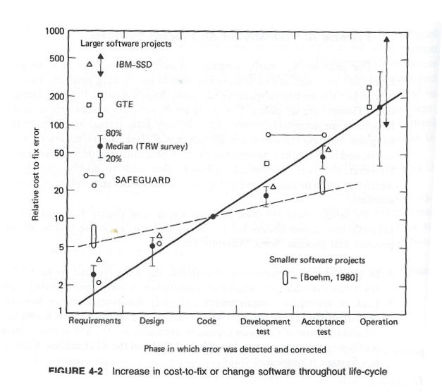
Remember the Cost of Change Curve?
Move defects leftwards to make them cheaper.
(defects means many things)
Pic via http://tinyurl.com/c-ching-cost-of-change
From Barry Boehm’s 1981 book:
Software Engineering Economics

Slide 20
Integrate soonest
Small units of work
Commit little and often
Don’t break the build.
Code is shared across multiple teams or projects regardless of release schedule or cadence.
Everyone can view and change all source.
Commit atomically regardless of the number of components touched
Continuously Integrate
Publish breakage news ASAP. Pre-commit is best.
Scale this to make it fast (through parallelization).
Continuous Review
Pre-commit is best – make it a rule.
CD
things
Eliminate risk from unreleased code
Pivot after valuation
“In prod” sooner allows for a quicker evaluation and maybe changes of plan.

Slide 21
How to get there (top level)

Slide 22
Note: pull request (for personal task branches) is still a ‘trunk’ approach
(from my blog:
“Trunk
Correlated
Practices”)

Slide 23
Checklist
Agile’s INVEST principal should allow for smallest “stories”
Get good with build-flags and toggles (flip things on/off in prod)
Branch by Abstraction allows you do implement longer to achieve, often non functional changes w/o making a branch
Multiple Continuous Integration Pipelines guard all the meaningful toggle/flag permutations for every commit
Continuous (Code) Review should be a priority over new stories
Common code ownership is a must
Live the Test Pyramid
New Mantra: “Don’t break the build”

Slide 24
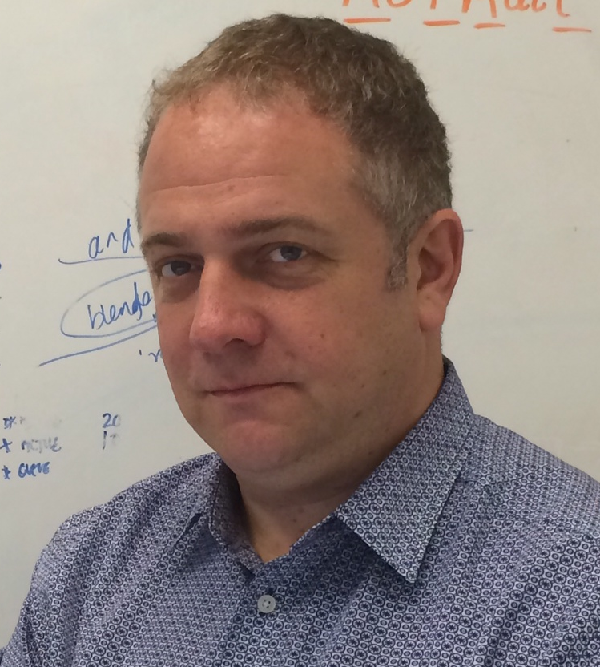
Paul Hammant Principal Consultant ThoughtWorks
Paul Hammant is a Principle Consultant at ThoughtWorks. He has been implementing (and witnessing) Trunk Based Development for 14 years in the the UK and USA. He blogs frequently on the topic, and has helped push the science a little with “Branch by Abstraction” in 2007. He's generally obsessed with source-control, particularly for novel uses.

Slide 25
Thank you!
See also the Forrester Report:
More Engineering, Less Dogma:
The Path Toward Continuous
Delivery Of Business Value
http://tinyurl.com/forrester-tbd
Paul Hammant paul@thoughtworks.com @paul_hammant

